Slide 1

Module 1.4
File management

Slide 2
Contents
Introduction
File/Windows Explorer
The need to organise
More about files
Working with files and folders
Test and improve
Module activities

Slide 3

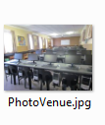
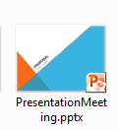
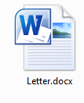

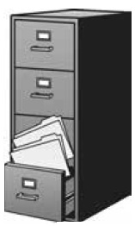
Introduction
Computer work is saved in files
Electronic files need to be organised, just as in a manual filing system

Slide 4
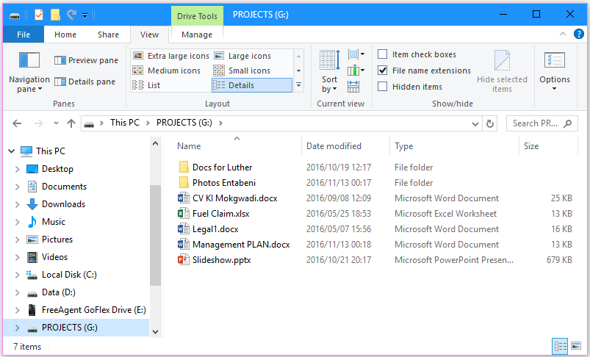
File/Windows Explorer
File management program supplied with all Windows operating systems
Back and Forward
4
Address bar
1
2
3
Search box
5
Toolbar and menu bar (Ribbon)
Left (Navigation) pane
6
Right (Details) pane

Slide 5
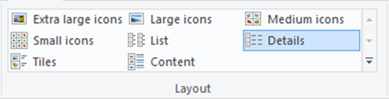
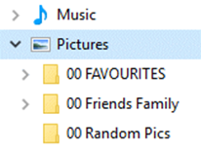
Activities 1 & 2

Slide 6
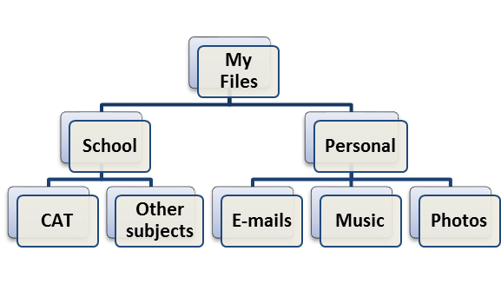
The need to organise
Plan your basic folder structure on paper or use SmartArt in Word
Main folders: School & Personal
Add subfolders as needed
Refine each level
Meaningful folder and file names
Keep same folder structure on all computers you use

Slide 7
Activity 3

Slide 8
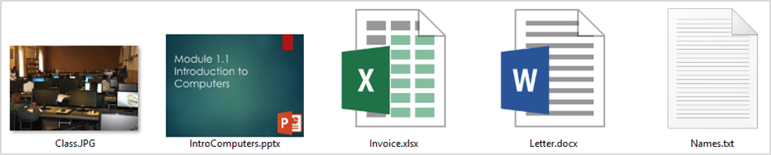
More about files
Each program stores the files it creates in its own way.
Each file type is given a unique icon.
Class.JPG
IntroComputers.pptx
Invoice.xlsx
Letter.docx
Names.txt

Slide 9
More about files
File name consists of three parts:
Birthday List . docx
name
extension
dot
Name: as given by the user
May consist of all the alphabetical characters, some special characters, the digits (0 to 9), and spaces
Extension: three or four letter code that identifies the file type
Automatically added by the program when you save the file

Slide 10
More about files
The file extension indicates
what type of file it is, and
which program should be used to open it
Never change the file extension of an existing file MANUALLY

Slide 11
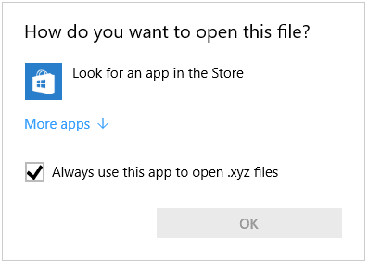
More about files
Windows can’t open this file!
To open this file you can:
See list of suggested programs
Search Internet for suitable program
Change or set default program
Right-click file and use Open With command

Slide 12
More about files
Paths
D drive
Invoices
2017
Documents
The path to a specific file might be ...
D:\ Documents \ Invoices \ 2017

Slide 13
More about files
File type | File extension
Graphics | jpeg, jpg, bmp, gif, tiff, png
Office | docx, xlsx, pptx, accdb
Audio | mp3, wav, cda, wma
Video | mp4, mpeg, asf, wmv, avi
Program | exe, com
Portable Document Format | pdf
Compressed | zip, rar
(Plain) text | txt
Rich Text Format | rtf
Hypertext Markup Language | html, xhtml
Common file types and extensions

Slide 14
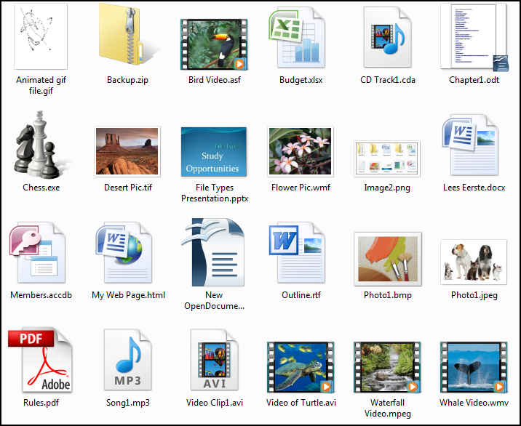
More about files
Common file types and extensions

Slide 15


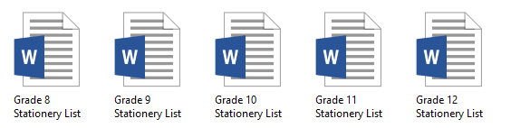
Working with files
The main operations on files and folders
Copy or Move
Delete
Rename
Sort

Slide 16
Activity 4

Slide 17

Working with files
The Recycle Bin
Files deleted from the hard drive are automatically sent to the Recycle Bin.
You can recover a file if you have not emptied the Recycle Bin ☺
But look out!
Files deleted from a network drive or from removable media (e.g. flash drive) are NOT sent to the Recycle Bin.

Slide 18
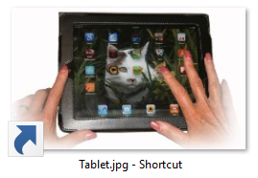
Working with files
You can create a shortcut to any file, folder or resource such as a printer
In ‘Extra large icons’ view in Explorer, shortcuts appear with an arrow in the bottom left corner.
A shortcut only points to the original item – it is not the item itself

Slide 19
Working with files
Work smarter – use the keyboard
<Ctrl><X>
<Ctrl><C>
<Ctrl><V>
<Ctrl><A>
Cut
Copy
Paste
Select All
Use Shift to select adjacent files
Use Ctrl to select non-adjacent files

Slide 20
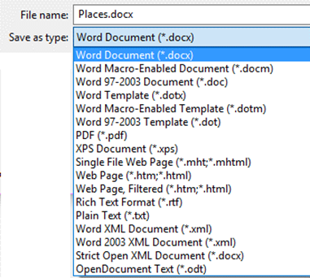
Working with files
Converting between file types
‘Save as type’ options in Word
Save the file in a format that can be read by other types of programs
This allows us to
Share data
Access the data with an older operating system

Slide 21
Activity 5

Slide 22
Test and improve
Summary – concepts, terms and tips
Planning a logical file structure
File names
File path
Network drives
Common file types and extensions
File properties
Recycle Bin
Shortcuts
Convert file types

Slide 23
Written module activity

